Slide 1
Supply Chain Inventory Health & Supplier Performance
Business Impact Brief
By N.SAI DHANUSH

Slide 2
Frequent Stockouts & Late Deliveries Hurt Profitability
Lost sales due to stockouts
Higher buffer stock costs
Customer dissatisfaction

Slide 3
Integrated Analytics Reveals Inventory & Supplier Risk
Combined data: Inventory, Orders, Suppliers
Python EDA & stats tests
Power BI dynamic dashboard
Excel what-if scenario

Slide 4
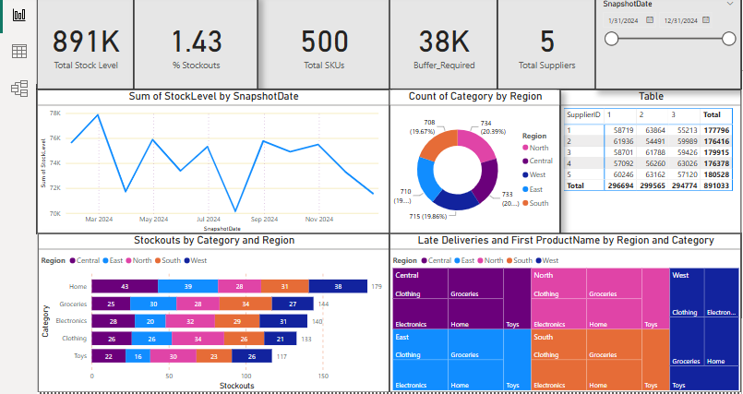
Inventory Health — 30% SKUs Below Reorder Point
• Total stock: 891K units
• % Stockouts: 1.4%
• Buffer needed: 38K units

Slide 5
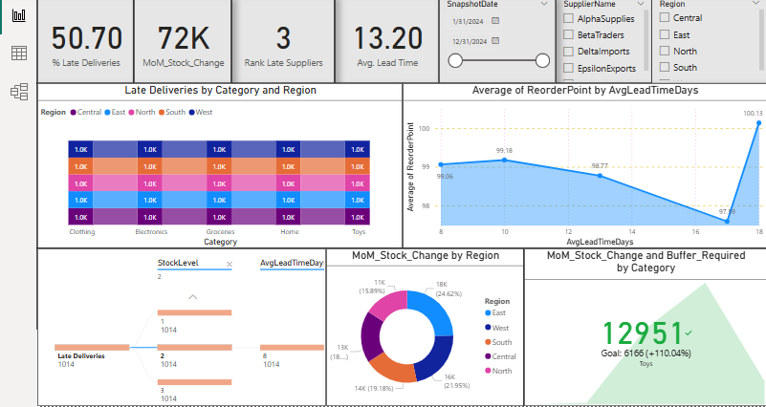
Supplier Risk — ~20% Orders Delivered Late
• % Late Deliveries: 50%
• Avg. Lead Time: 13 days
• Top late suppliers ranked

Slide 6
Scenario — +15% ReorderPoint Reduces Stockouts
Stockout risk reduced by ~15%
Higher holding cost trade-off
Tested via Excel pivot scenario

Slide 7
Recommended Actions
Adjust reorder policy
Prioritize supplier SLA talks
Automate dashboards
Integrate with ERP

